Slide 1
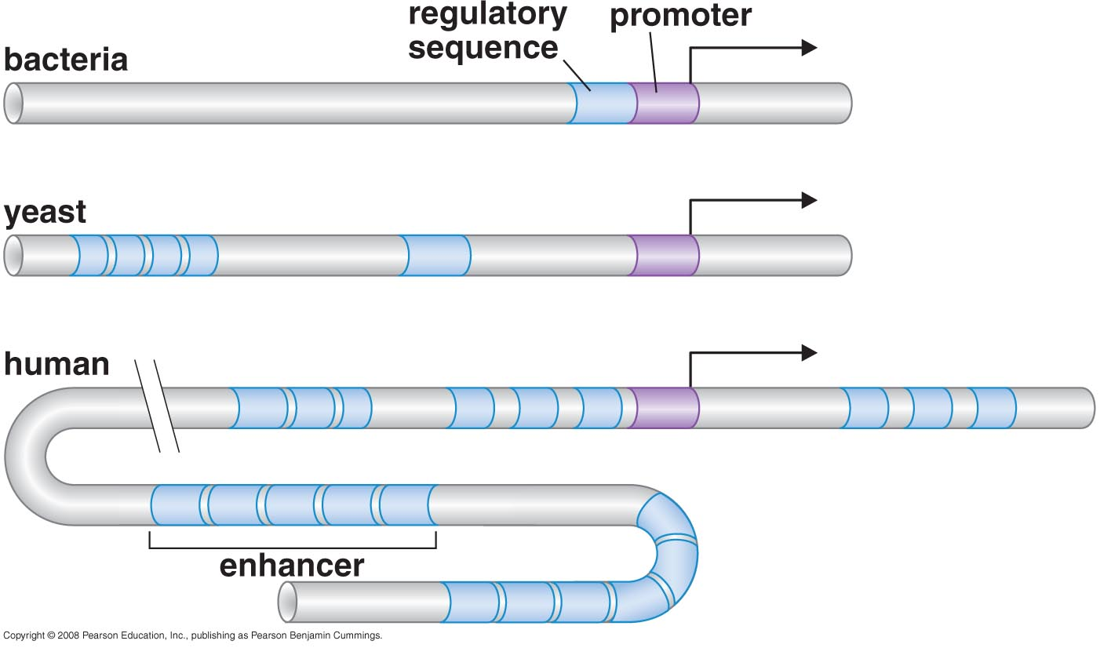
Transcriptional regulation in Eukaryotes
The regulatory elements of bacterial, yeast, and human genes

Slide 2
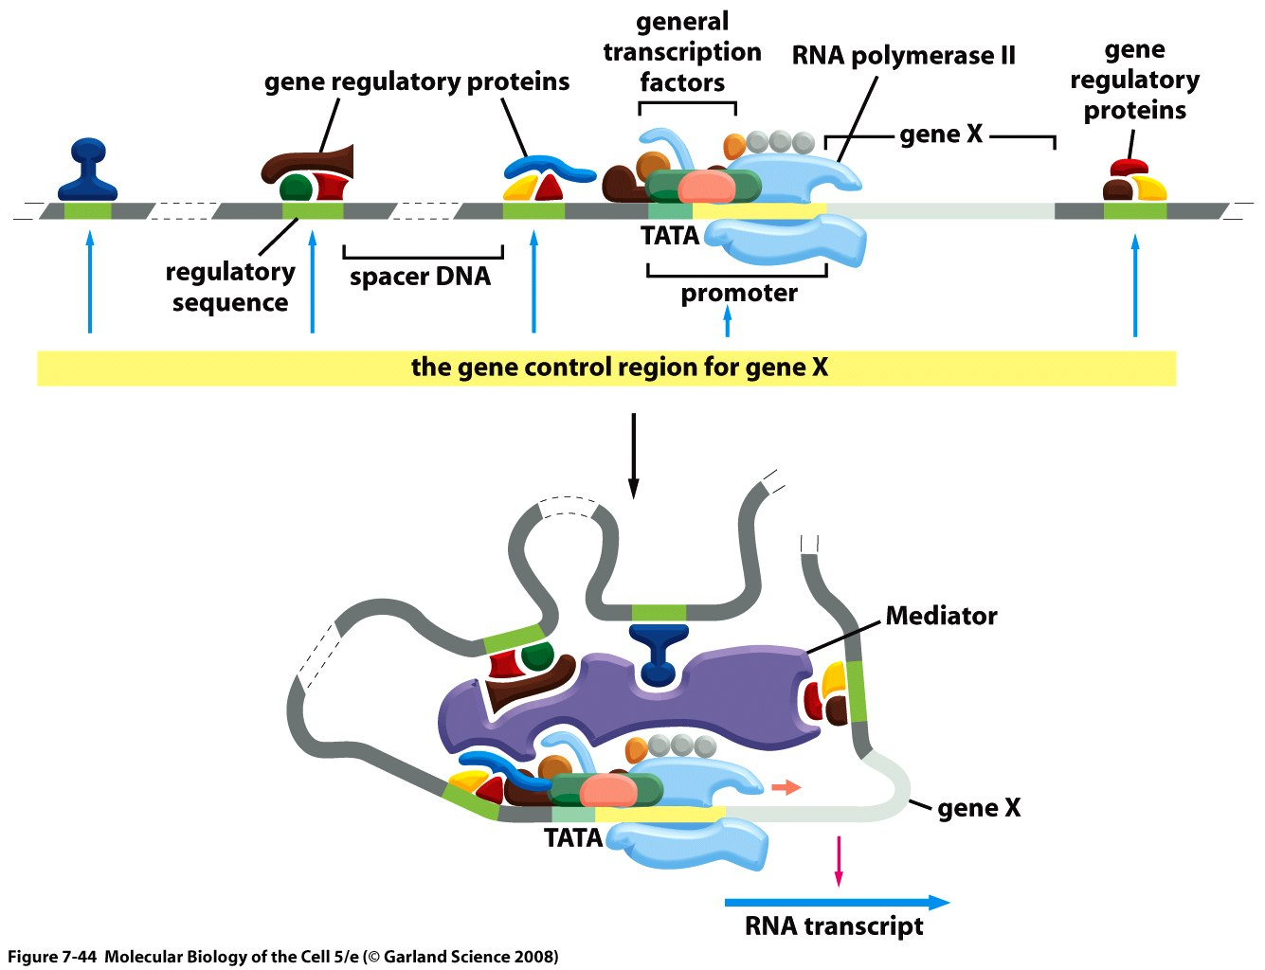
Regulation of gene expression in Eukaryotes
The gene control region of a typical eucaryotic gene.

Slide 3
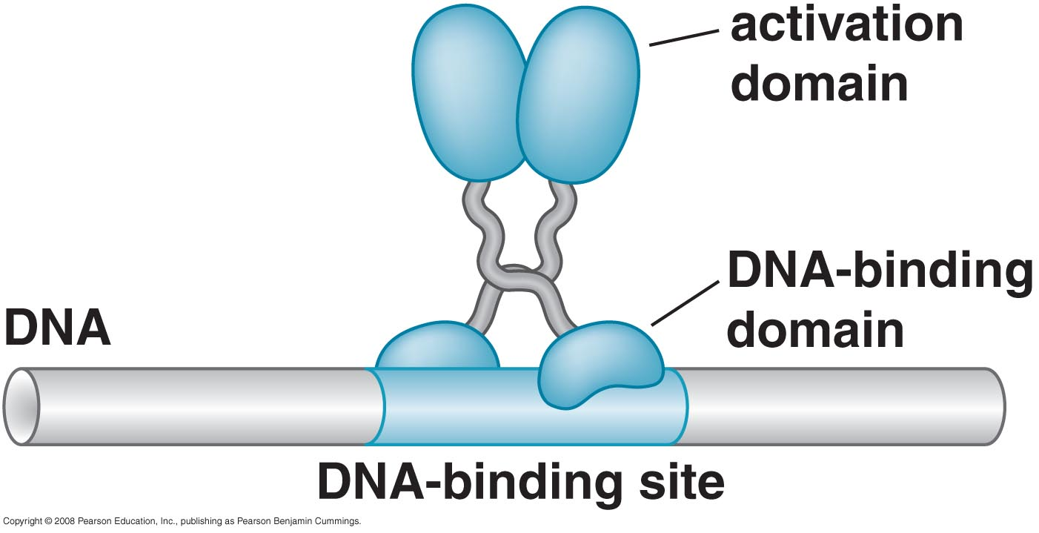
CONSERVED MECHANISMS OF TRANSCRIPTIONAL REGULATION FROM YEAST TO MAMMALS
Activators have separate DNA-binding and activating functions
Gal 4 bound to its site on DNA

Slide 4
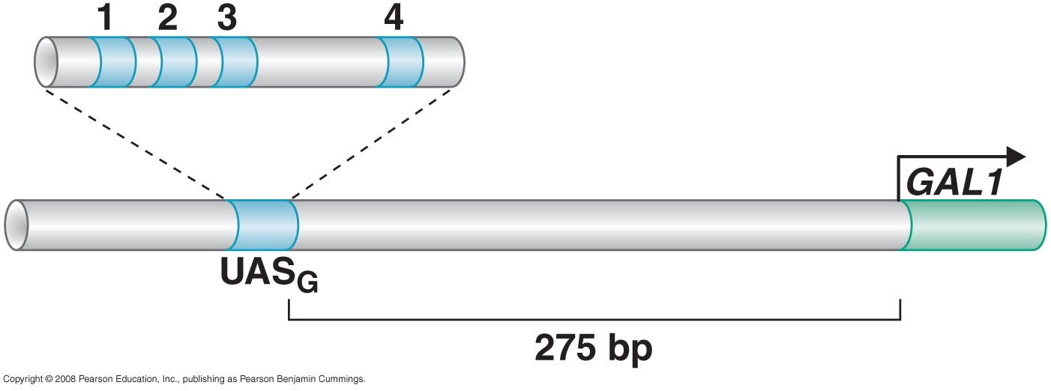
The regulatory sequences of the yeast GAL 1 gene

Slide 5
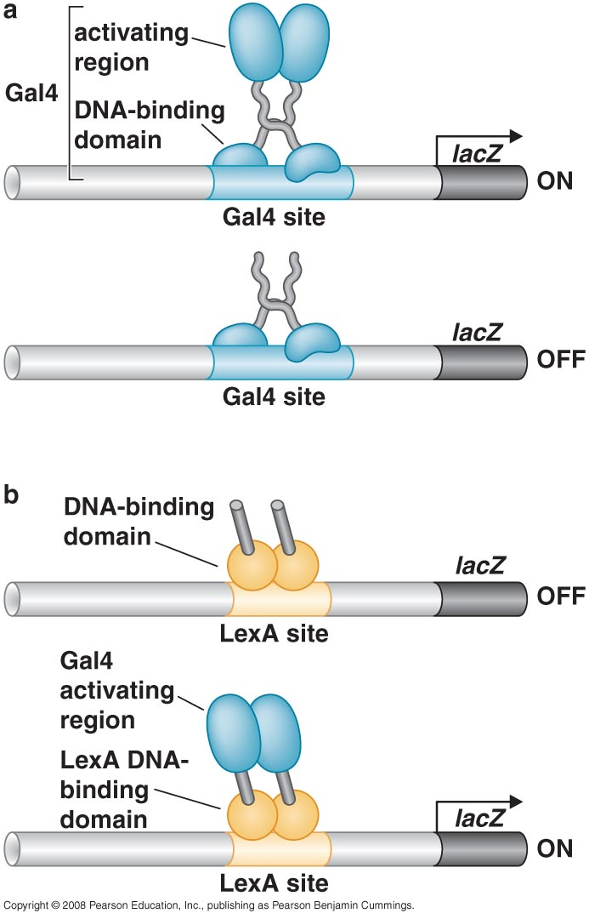
Domain swap experiment

Slide 6
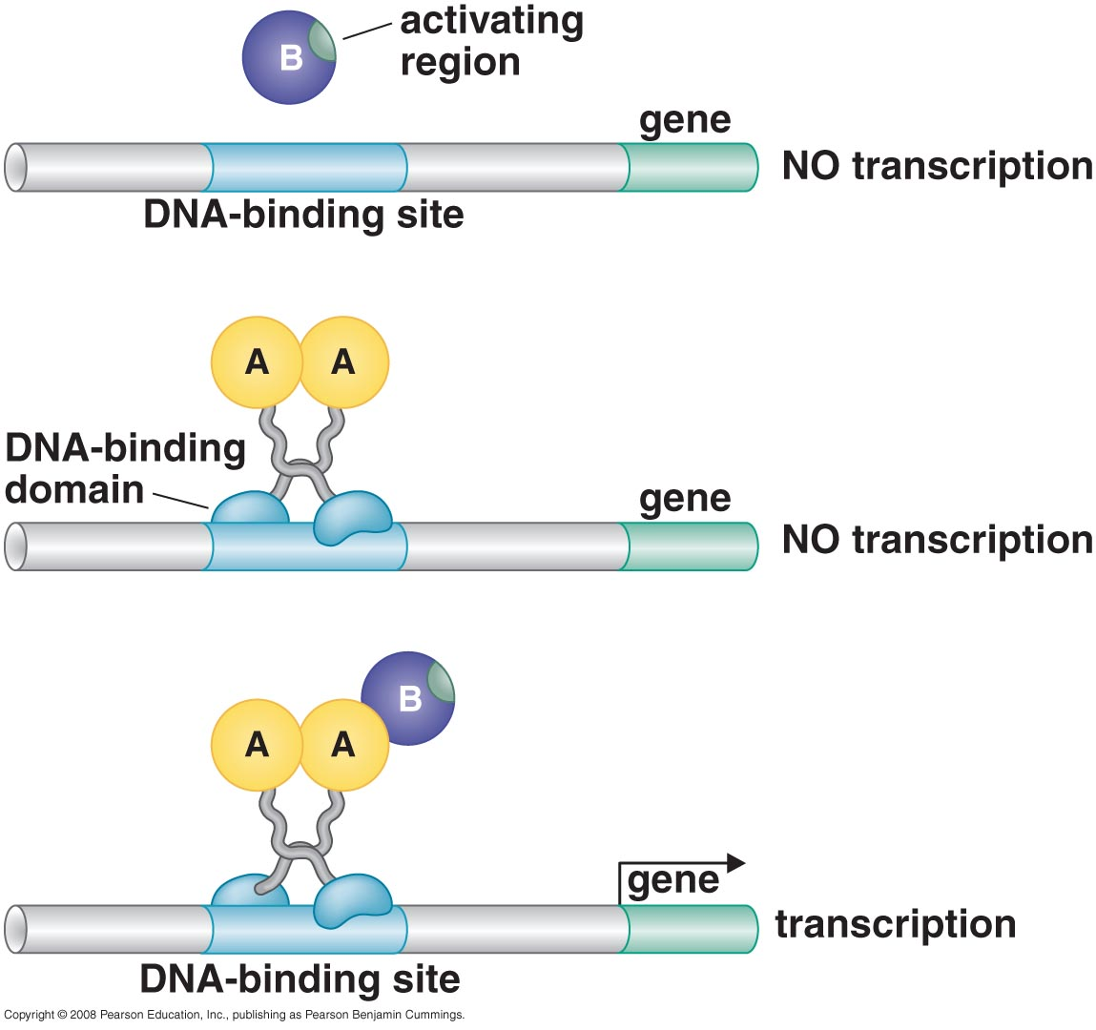
The yeast two-hybrid assay

Slide 7
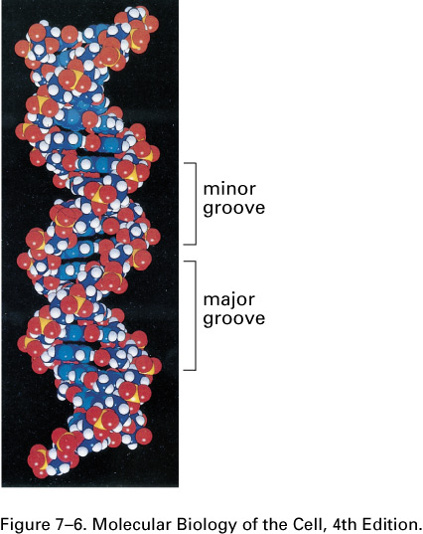
DNA-binding motifs in gene regulatory proteins (repressors; activators)
Double-helical structure of DNA.
The major and minor grooves on the outside of the double helix are indicated. The atoms are colored as follows: carbon, dark blue; nitrogen, light blue; hydrogen, white; oxygen, red; phosphorus, yellow.
The outside of DNA duplex can be read by
proteins

Slide 8
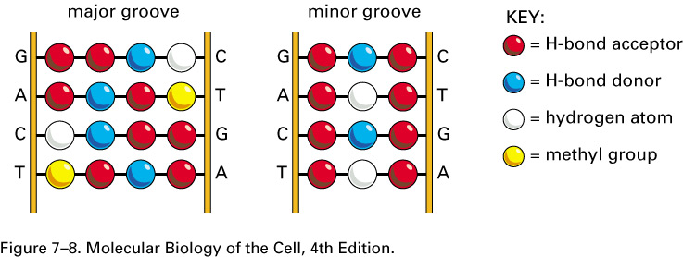
A DNA recognition code.
The edge of each base pair, seen here looking directly at the major or minor groove, contains a distinctive pattern of hydrogen bond donors, hydrogen bond acceptors, and methyl groups. From the major groove, each of the four base-pair configurations projects a unique pattern of features. From the minor groove, however, the patterns are similar for G–C and C–G as well as for A–T and T–A.

Slide 9
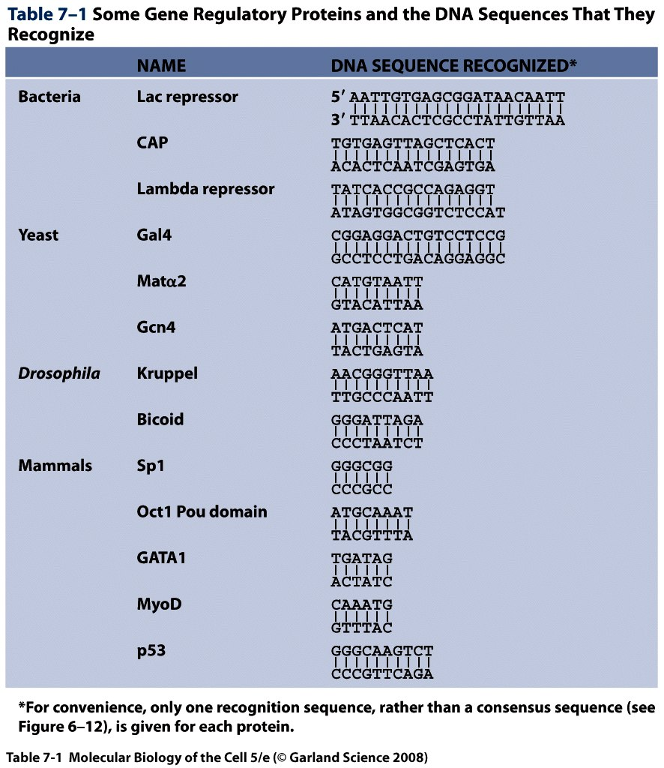
Short DNA sequences are fundamental components of genetic switches

Slide 10
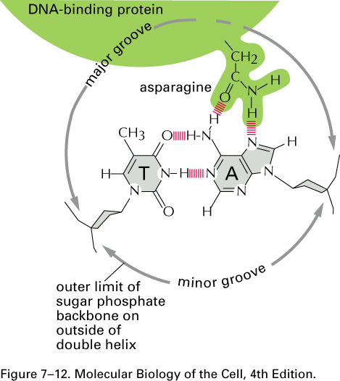
Gene regulatory proteins contain structural motifs that can
read DNA sequences
The binding of a gene regulatory protein to the major groove of DNA.
Only a single contact is shown. Typically, the protein-DNA interface would consist of 10 to 20 such contacts, involving different amino acids, each contributing to the strength of the protein–DNA interaction.

Slide 11
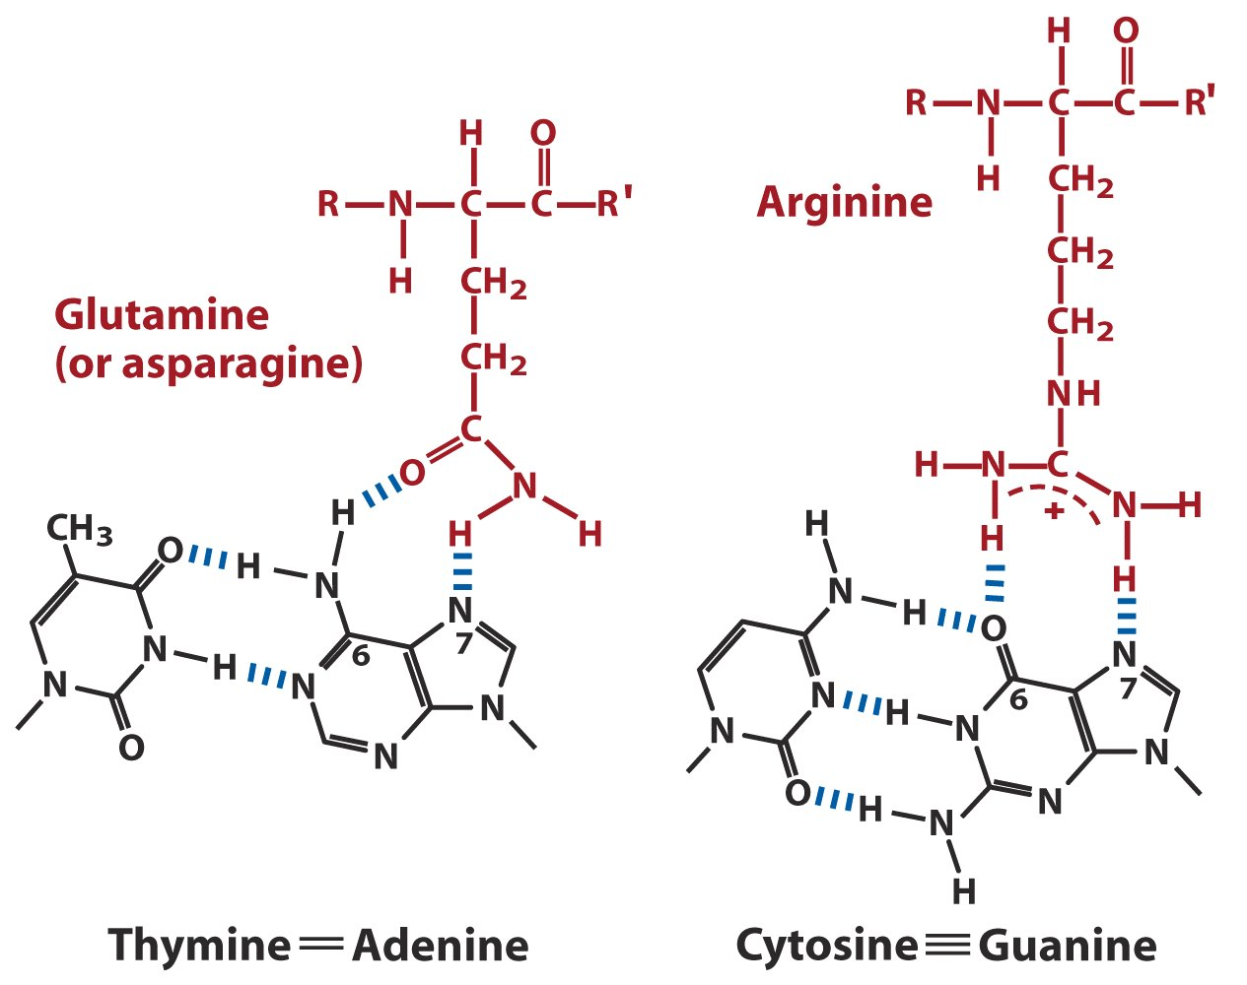
Two examples of specific amino-acid-base pair interactions in DNA-protein binding

Slide 12
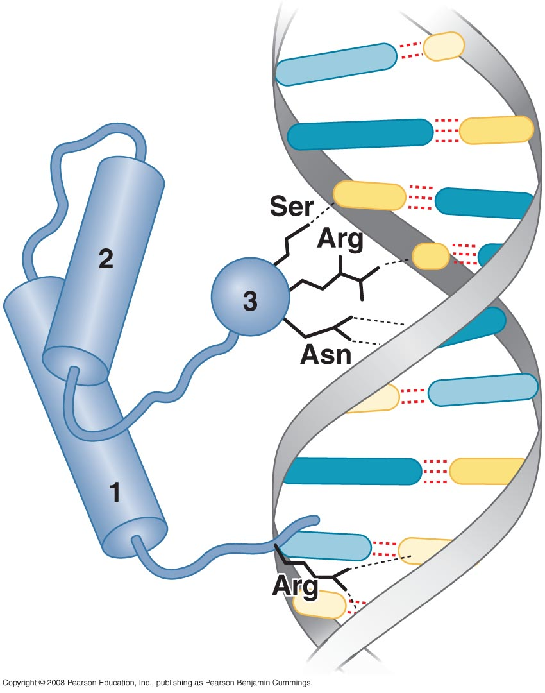
Eukaryotic regulators use a range of DNA-binding domains, but DNA recognition involves the same principles as found in bacteria
DNA recognized by a Homeodomain

Slide 13
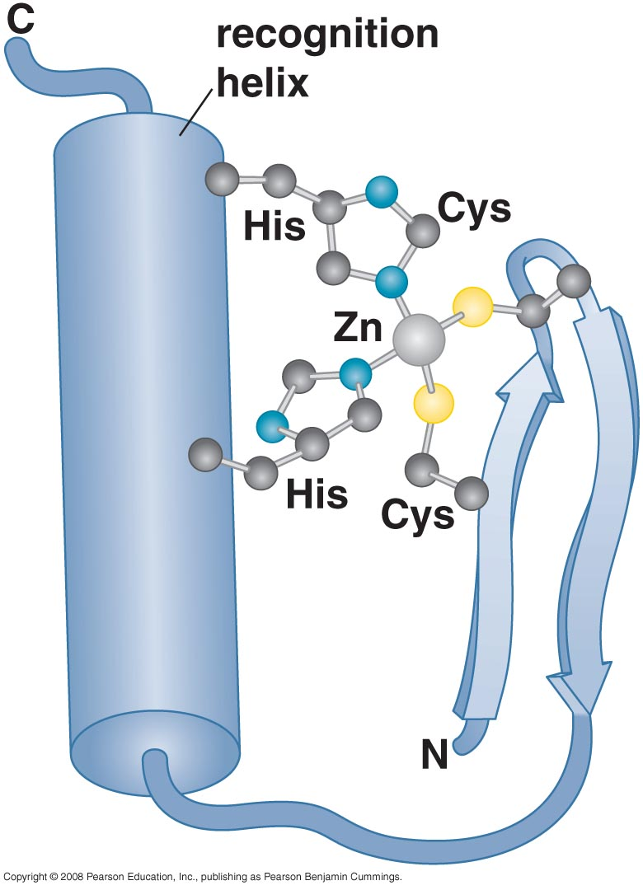
Zinc finger domain

Slide 14
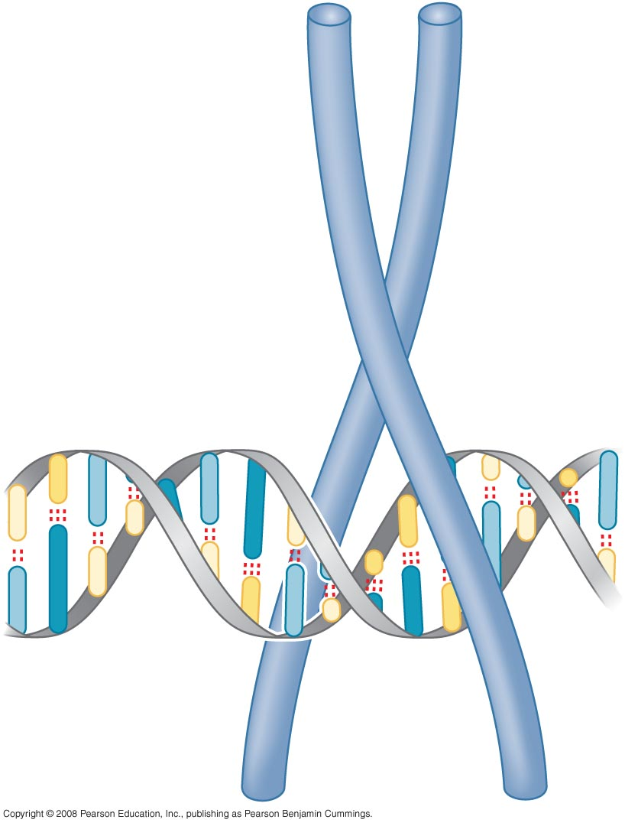
Leucine zipper

Slide 15
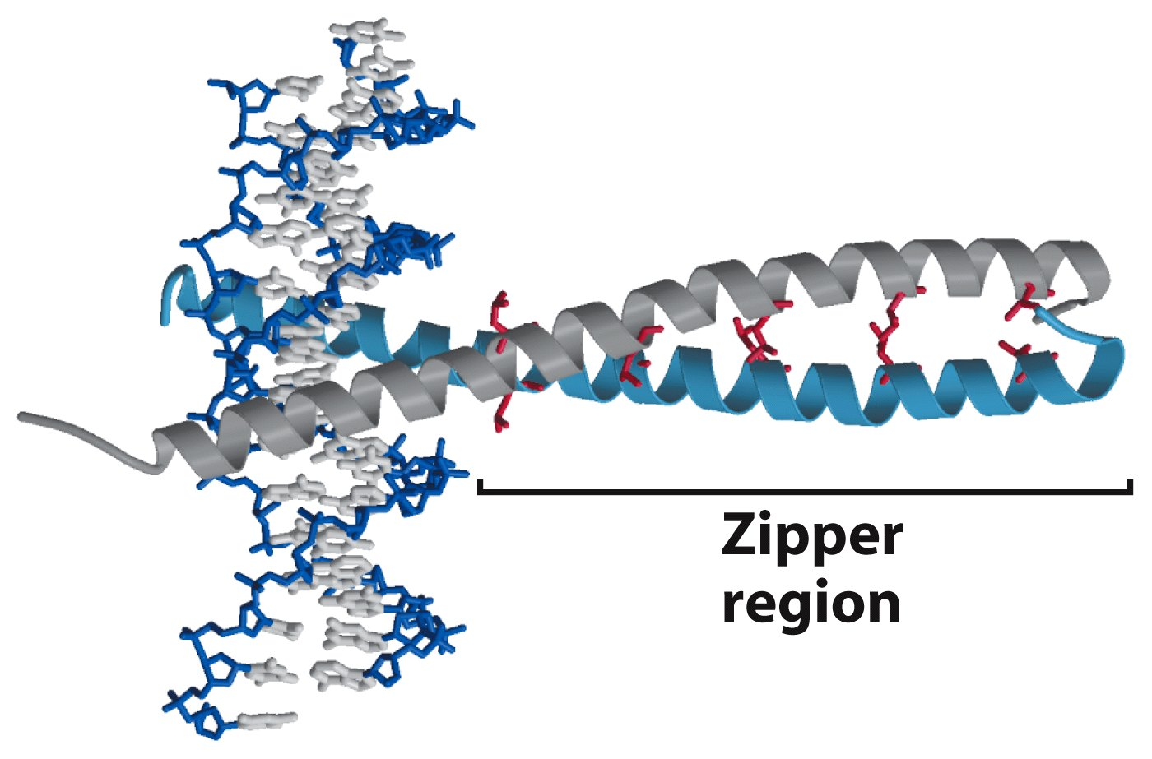
Leucine zipper motif mediates both DNA binding and protein dimerization

Slide 16
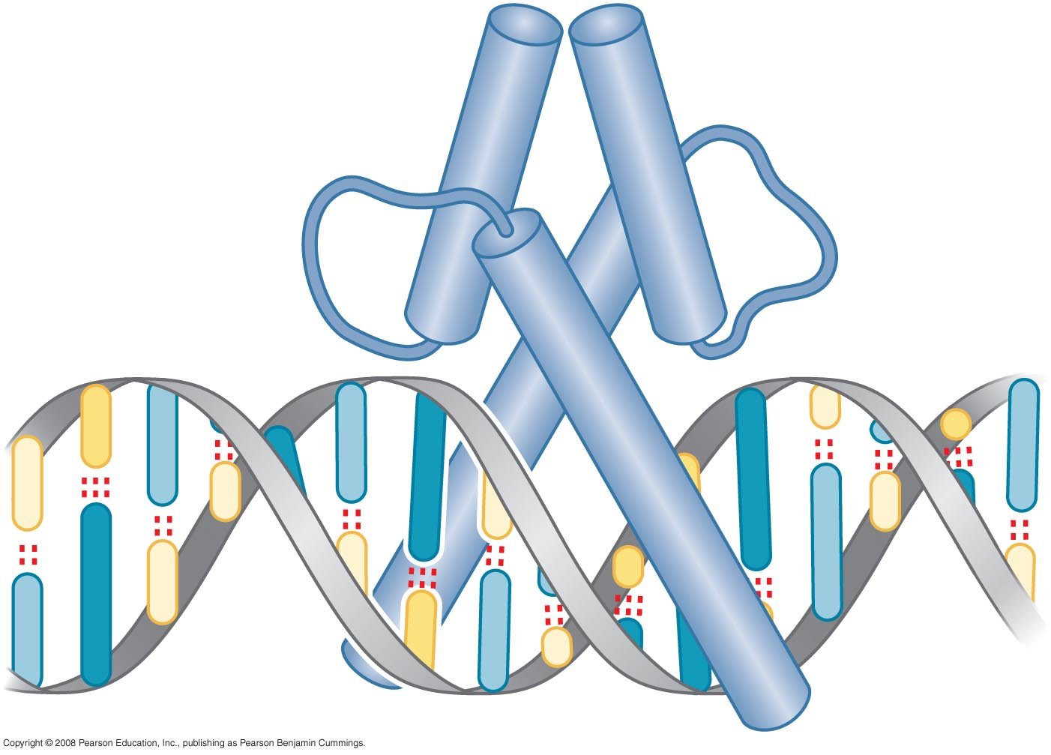
Helix-loop-helix

Slide 17
Activating regions are not well-defined structures

Slide 18
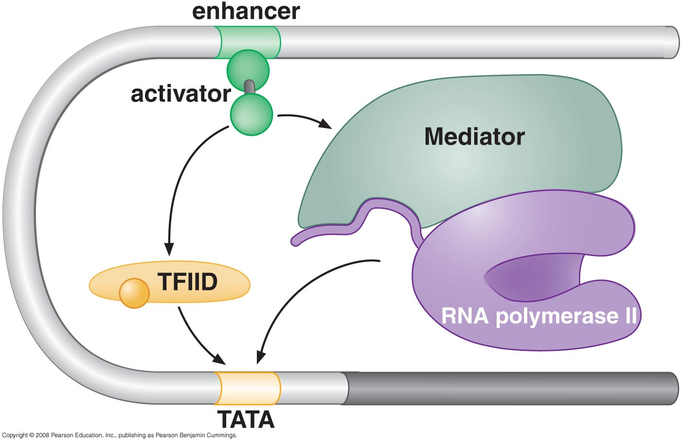
RECRUITMENT OF PROTEIN COMPLEXES TO GENES BY EUKARYOTIC ACTIVATORS
Activator recruit the transcriptional machinery to the gene

Slide 19
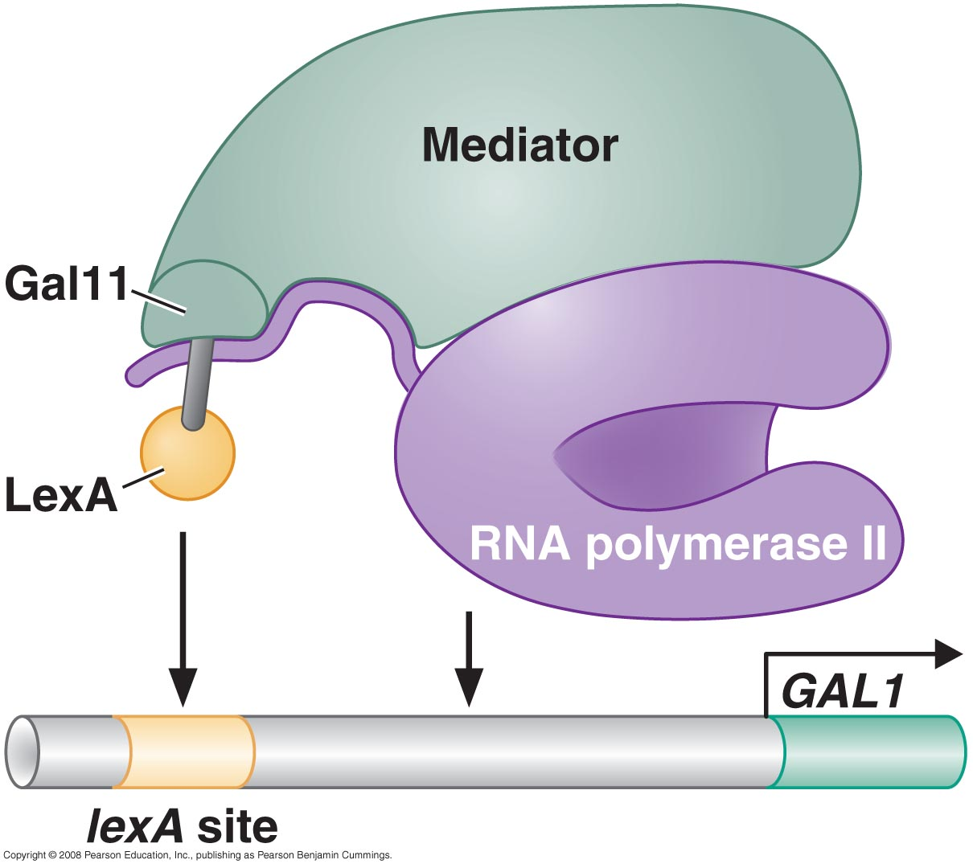
Activation of transcription through direct tethering of mediator to DNA

Slide 20
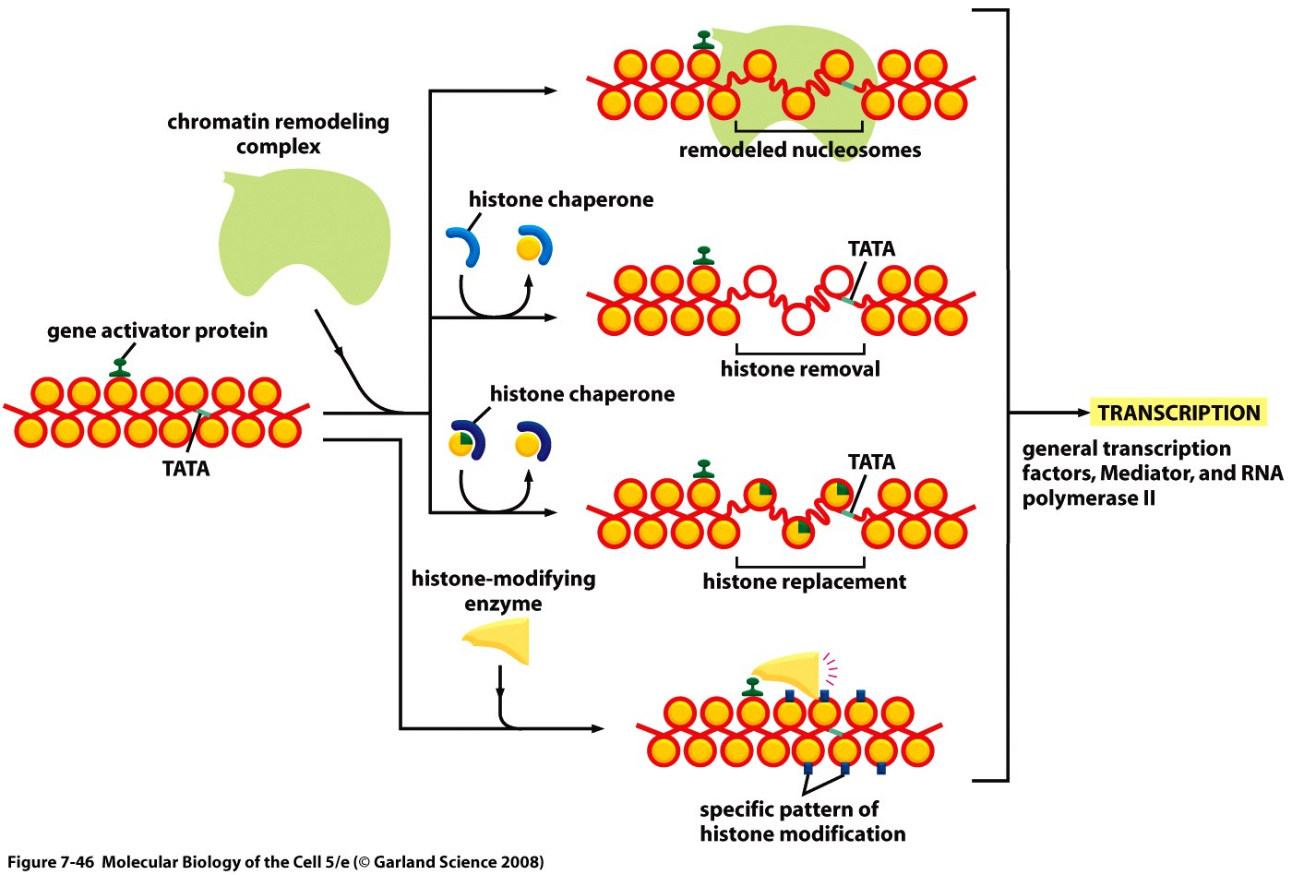
Activator also recruit nucleosome modifiers that help the transcriptional machinery bind at the promoter or initiate transcription

Slide 21
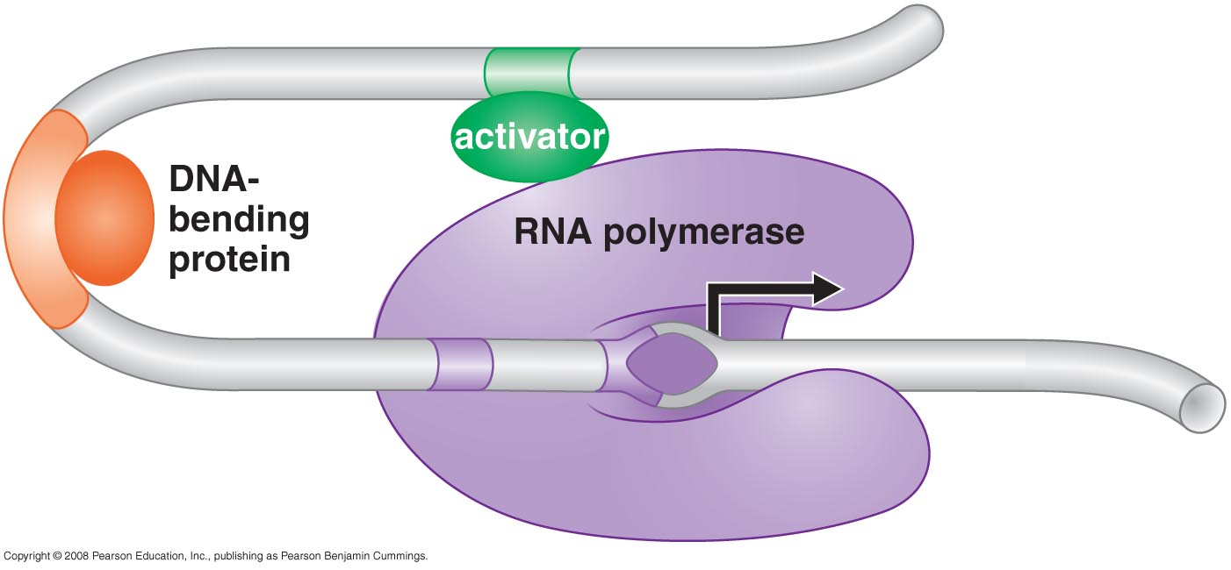
Action at a distance: loop and insulators

Slide 22
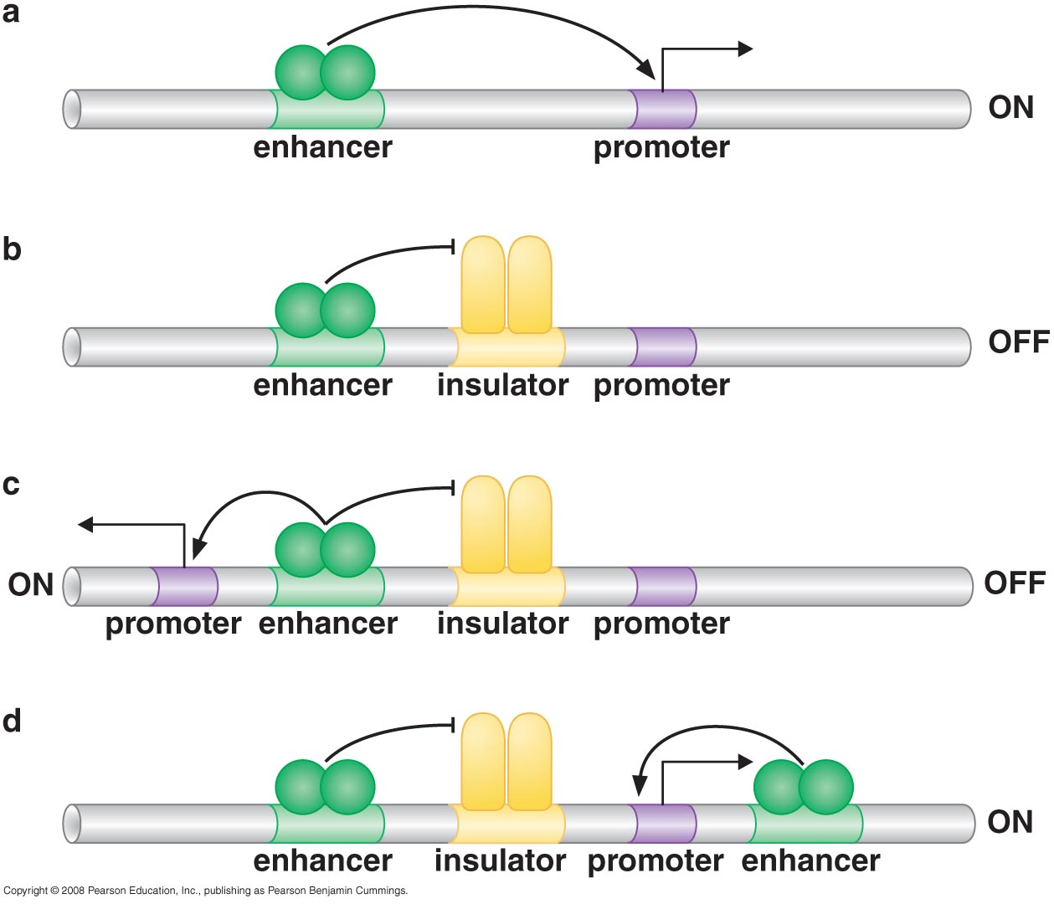
Insulators block activation by enhancers

Slide 23
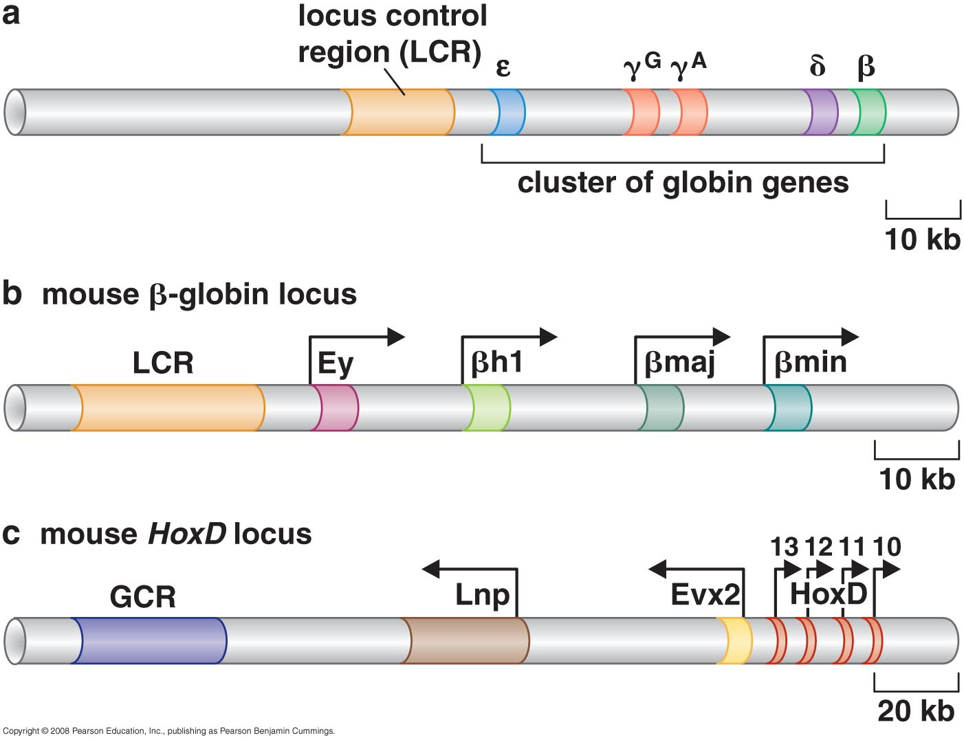
Appropriate regulation of some groups of genes requires locus control regions

Slide 24
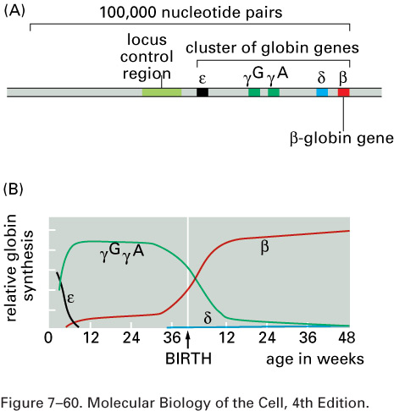
The cluster of β-like globin genes in humans.
(A) The large chromosomal region shown spans 100,000 nucleotide pairs and contains the five globin genes and a locus control region (LCR). (B) Changes in the expression of the β-like globin genes at various stages of human development. Each of the globin chains encoded by these genes combines with an α-globin chain to form the hemoglobin in red blood cells (see Figure 7–115).

Slide 25
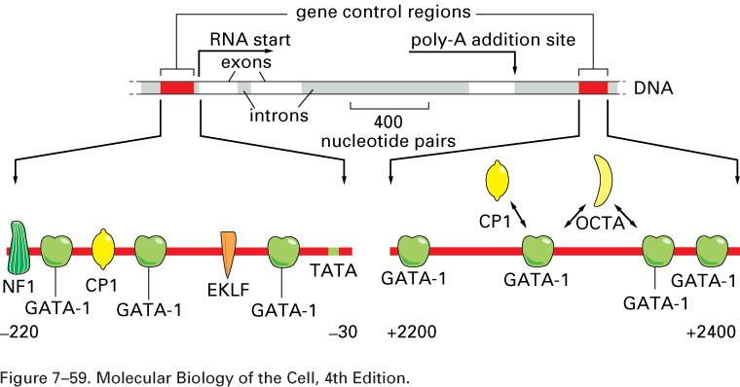
Model for the control of the human b-globin gene. The diagram shows some of the gene regulatory proteins thought to control expression of the gene during red blood cell development). Some of the gene regulatory proteins shown, such as CP1, are found in many types of cells, while others, such as GATA-1, are present in only a few types of cells—including red blood cells—and therefore are thought to contribute to the cell-type specificity ofb-globin gene expression. As indicated by the double-headed arrows, several of the binding sites for GATA-1 overlap those of other gene regulatory proteins; it is thought that occupancy of these sites by GATA-1 excludes binding of other proteins. Once bound to DNA, the gene regulatory proteins recruit chromatin remodeling complexes, histone modifying enzymes, the general transcription factors and RNApolymerase to the promoter

Slide 26
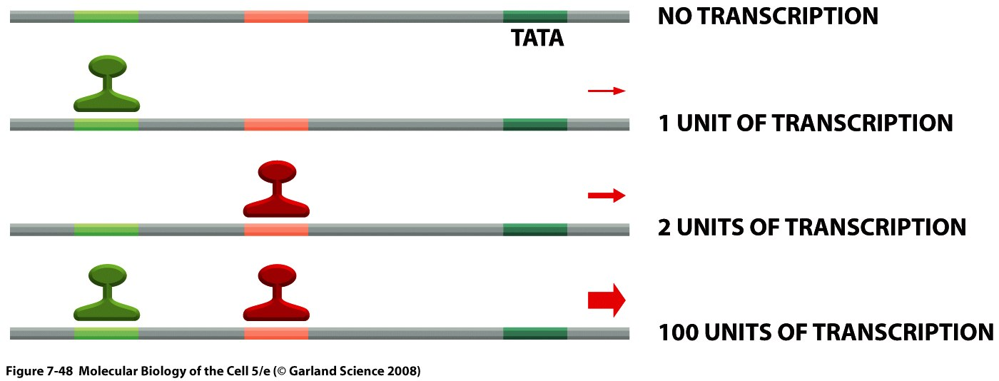
SIGNAL INTEGRATION AND COMBINATORIAL CONTROL
Activators work synergistically to integrate signals
Transcriptional synergy. In this experiment, the rate of transcription produced by three experimentally constructed regulatory regions is compared in a eucaryotic cell. Transcriptional synergy, the greater than additive effect of the activators, is observed when several molecules of gene activator protein are bound upstream of the promoter. Synergy is also typically observed between different gene activator proteins from the same organism and even between activator proteins from widely different eucaryotic species when they are experimentally introduced into the same cell. This last observation reflects the high degree of conservation of the transcription machinery.

Slide 27
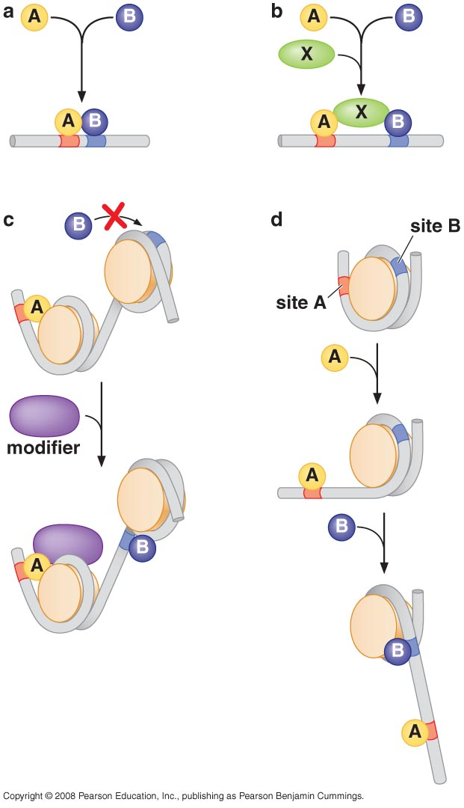
Synergy resulted from cooperative binding of activators

Slide 28
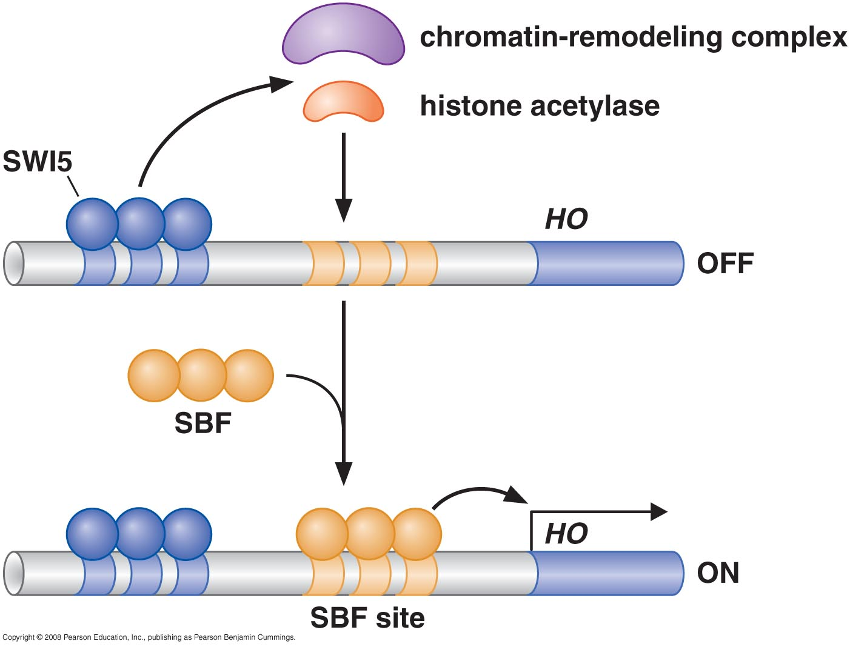
Signal integration: The HO gene is controlled by two regulators- one recruits nucleosome modifiers and the other recruits mediators

Slide 29
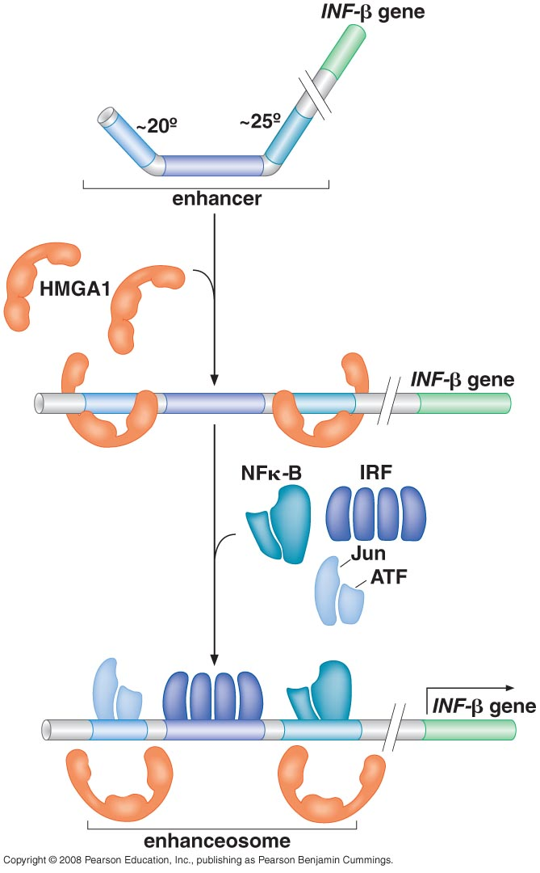
Signal integration: Cooperative binding of activators at the human β-interferon gene

Slide 30
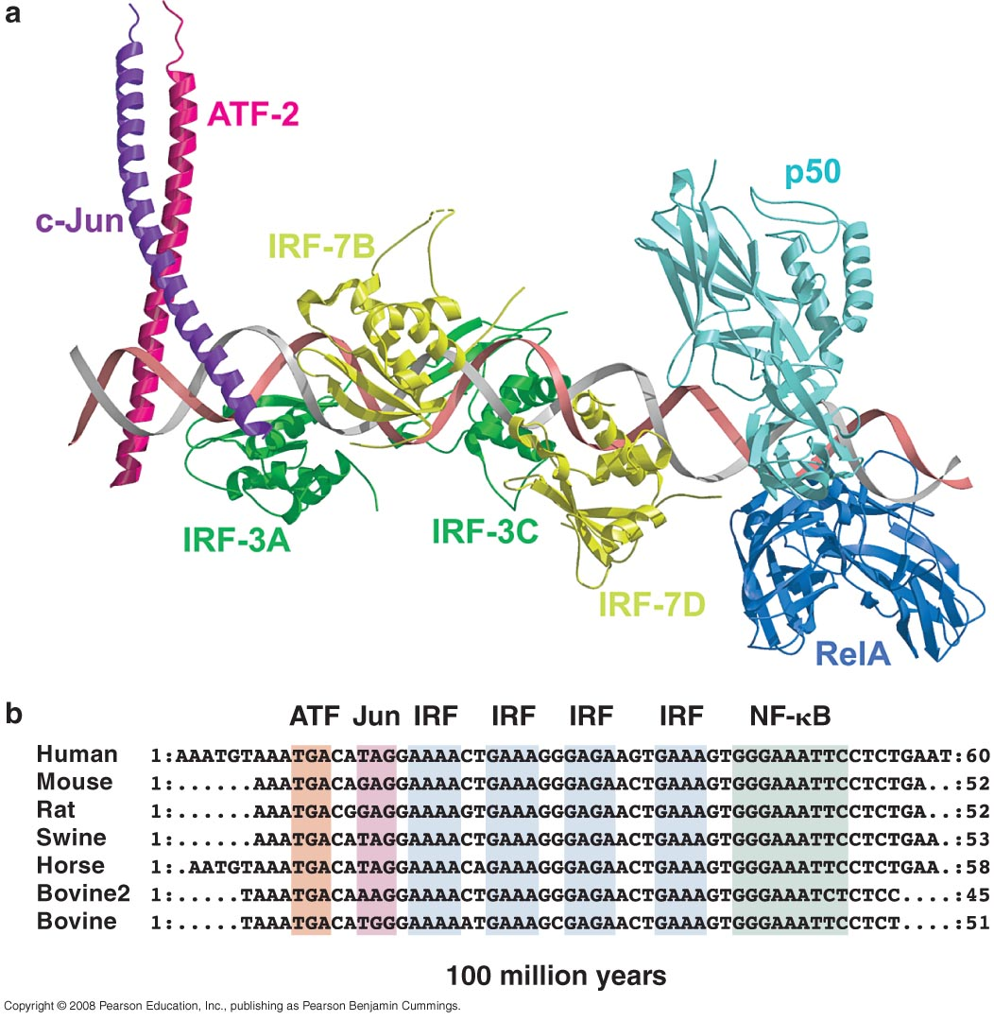
The enhancesome structure and the DNA sequences they bound

Slide 31
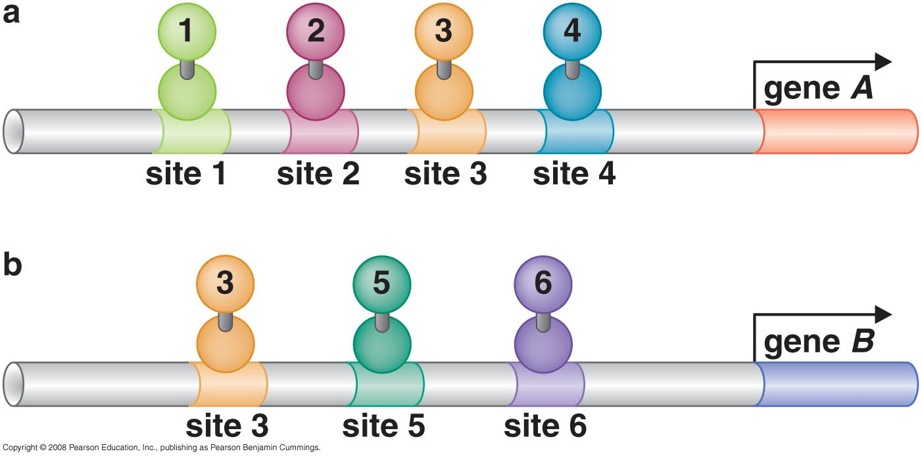
Combinatorial control lies at the heart of the complexity and diversity of eukaryotes

Slide 32
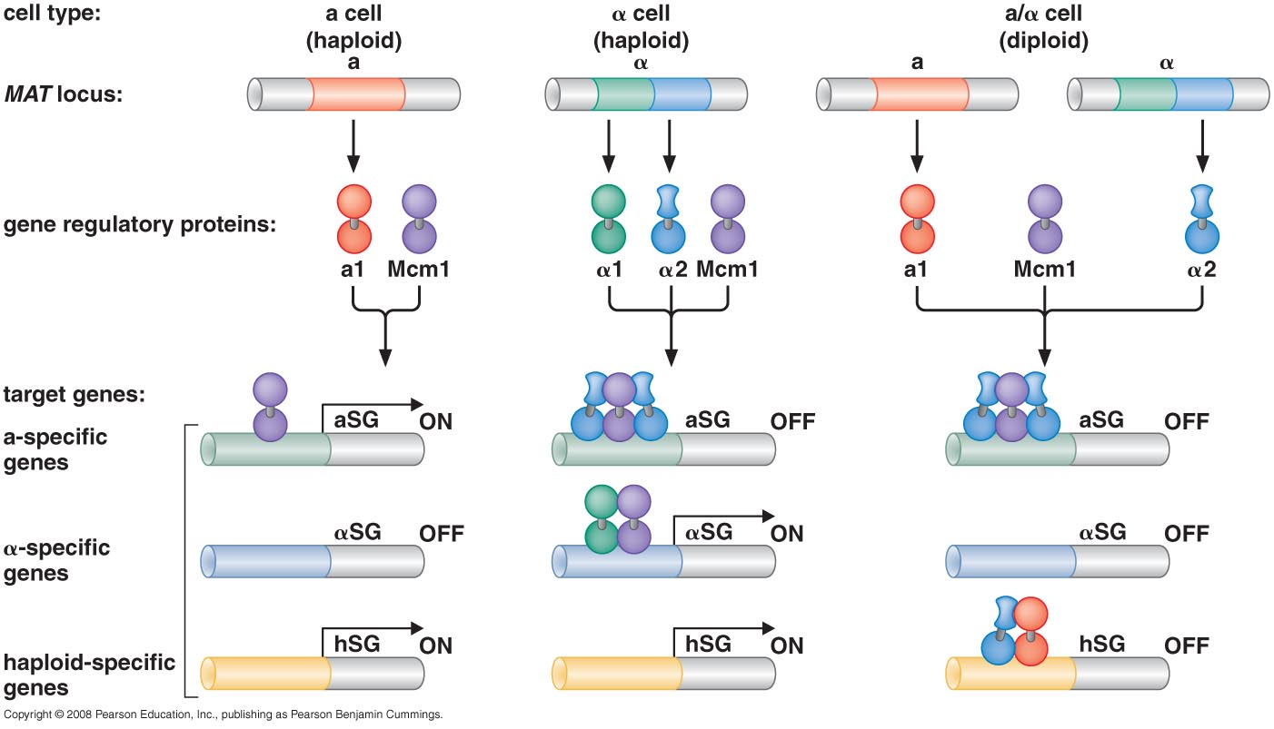
Combinatorial control of the mating-type genes from yeast

Slide 33
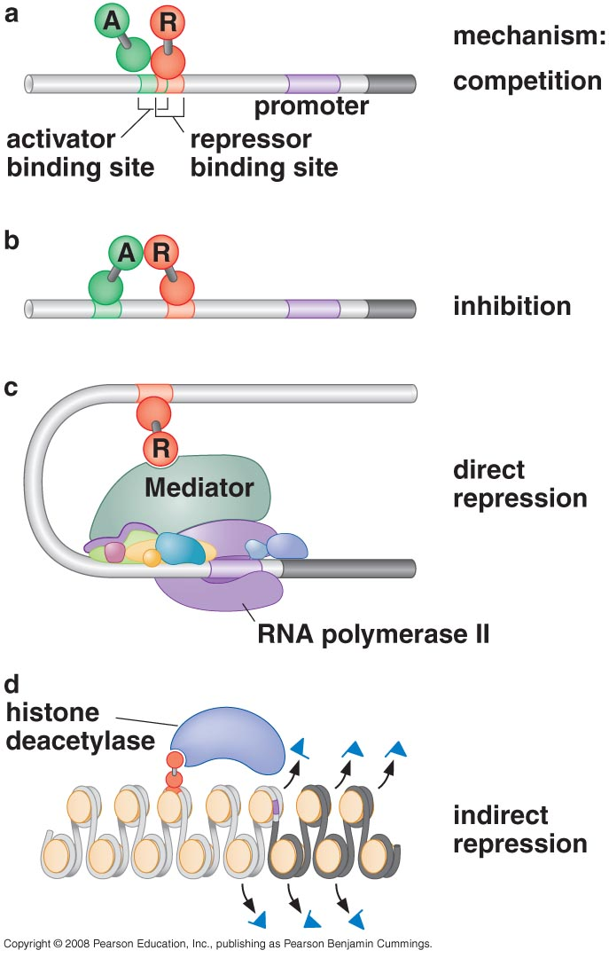
TRANSCRIPTIONAL REPRESSORS

Slide 34
Repression of GAL1 gene in yeast

Slide 35
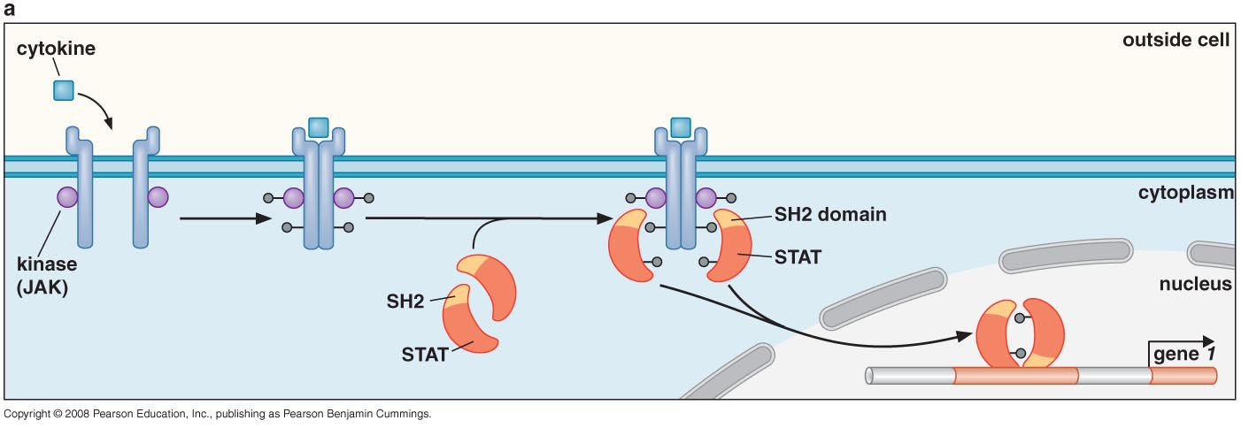
SIGNAL TRANSDUCTION AND THE CONTROL OF TRANSCRIPTIONAL REGULATORS
Signals are often communicated to transcriptional regulators through signal transduction pathways
STAT (signal transducer and activator of transcription) pathway

Slide 36
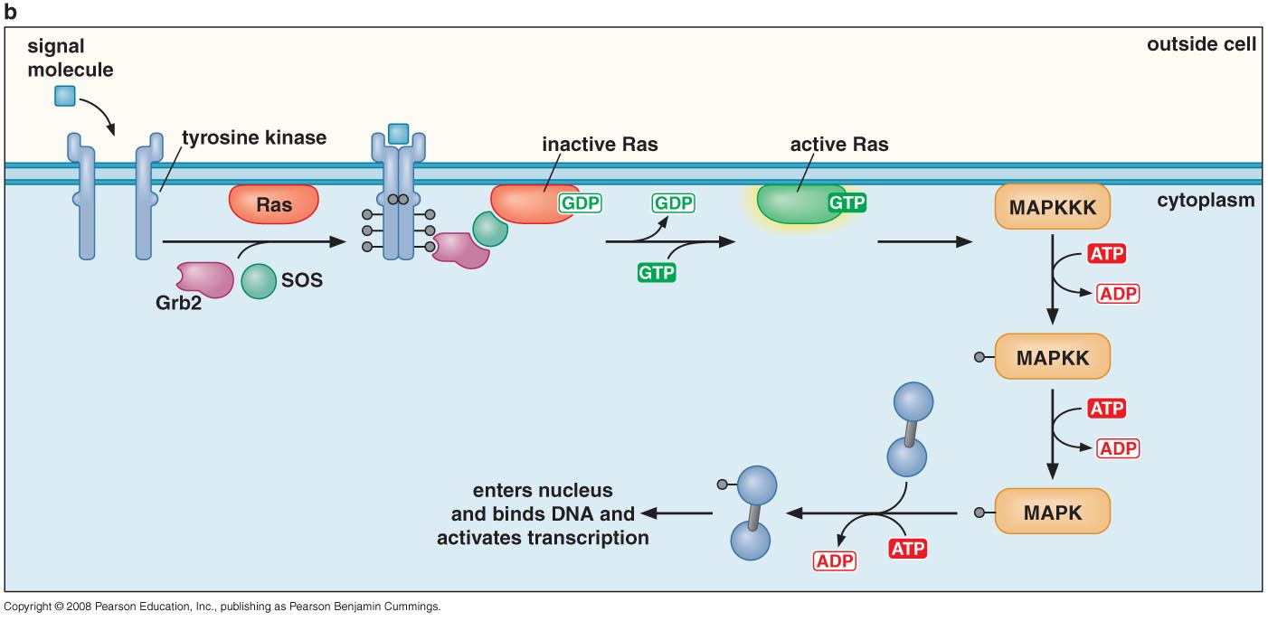
The MAPK (mitogen-activated protein kinase) pathway

Slide 37
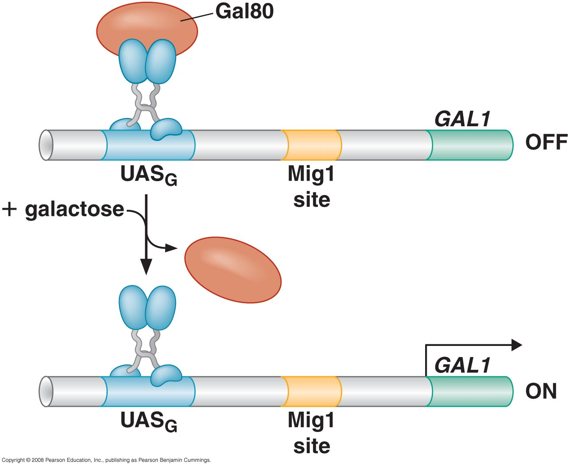
Signals control the activities of eukaryotic transcriptional regulators in a variety of ways (Unmasking an activating region; transport into and out of the nucleus)

Slide 38
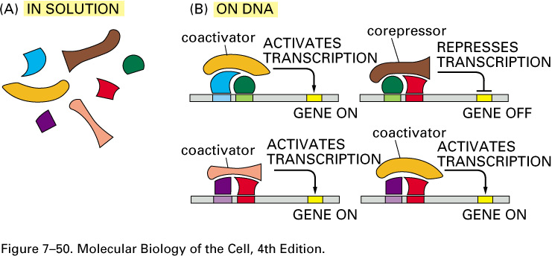
Activators and repressors sometimes come in pieces

Slide 39
GENE “SILENCING” BY MODIFICATION OF HISTONES AND DNA
Silencing in yeast in mediated by deacetylation and methylation of histones

Slide 40
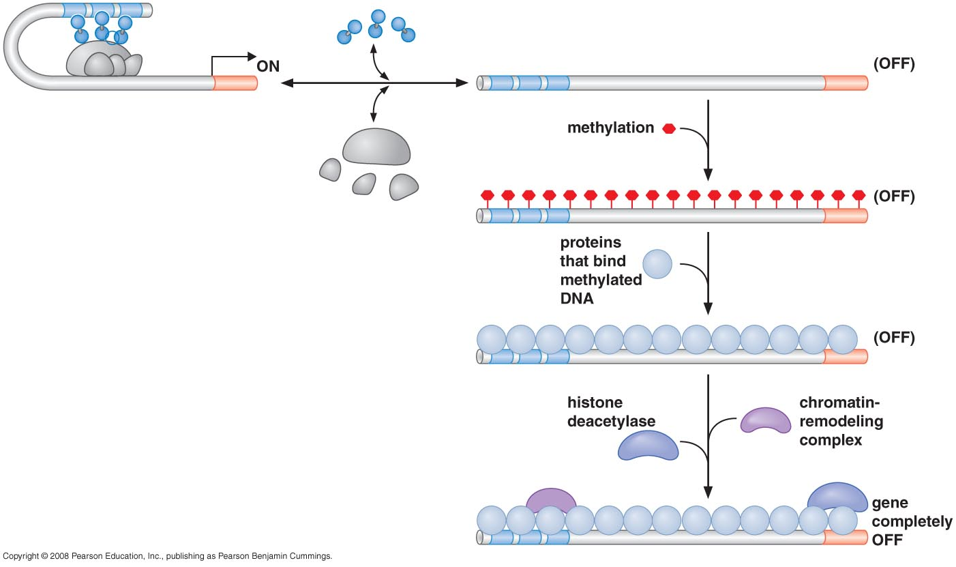
In Drosophila, HP1 recognizes methylated Histones and condenses chromatin

Slide 41
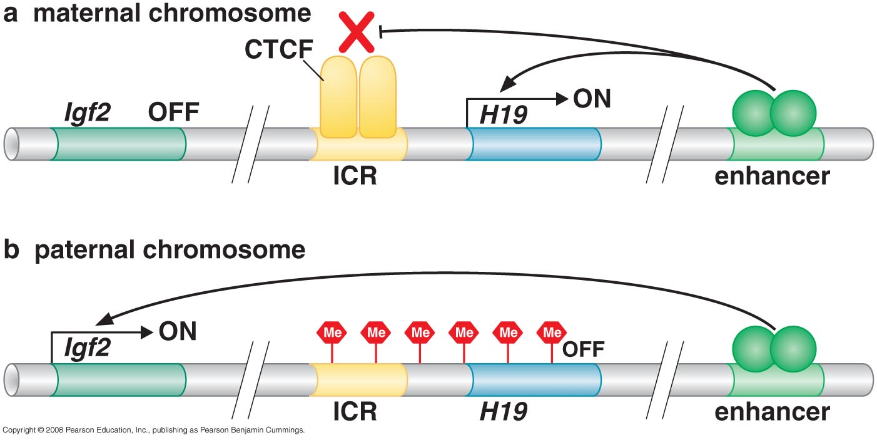
DNA methylation is associated with silenced genes in mammalian cells

Slide 42
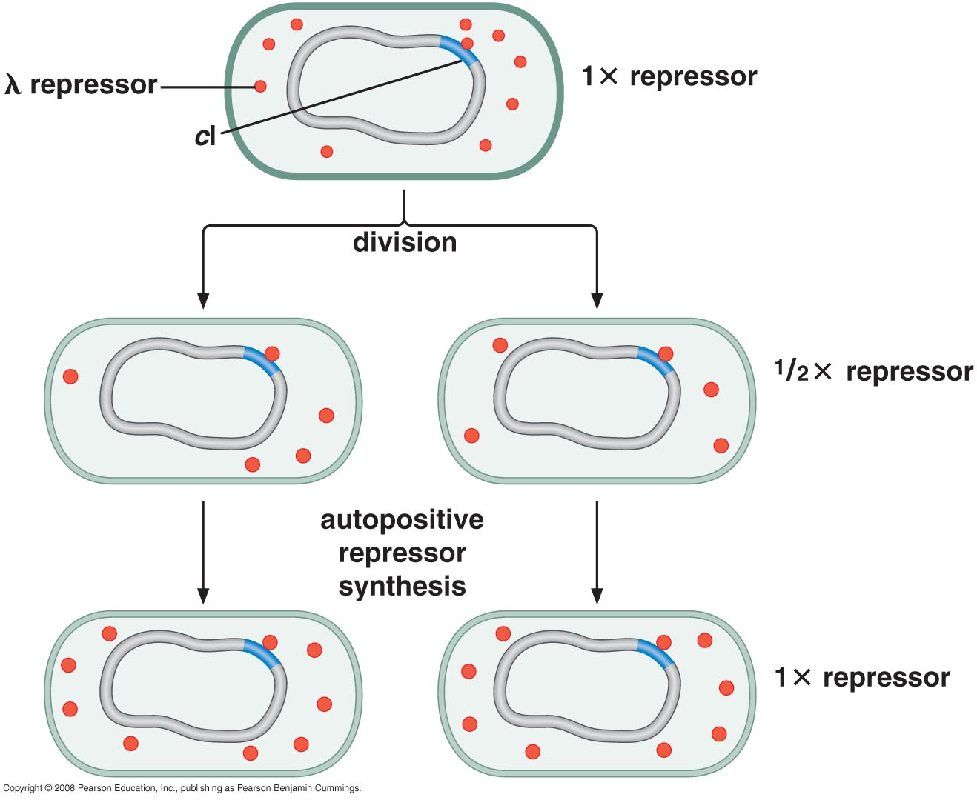
EPIGENETIC GENE REGULATION
The inheritance of gene expression patterns, in the absence of both mutation and the initiating signal, is called epigenetic regulation
Some states of gene expression are inherited through cell division even when the initiating signal is no longer present

Slide 43
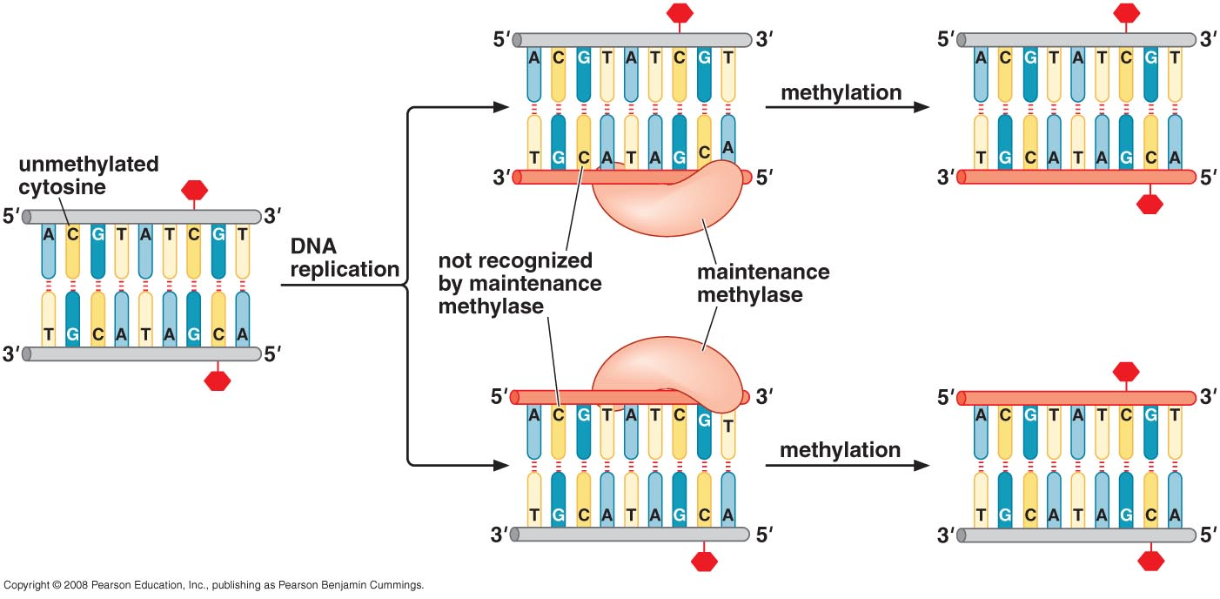
Patterns of DNA methylation can be maintained through cell division

Slide 44
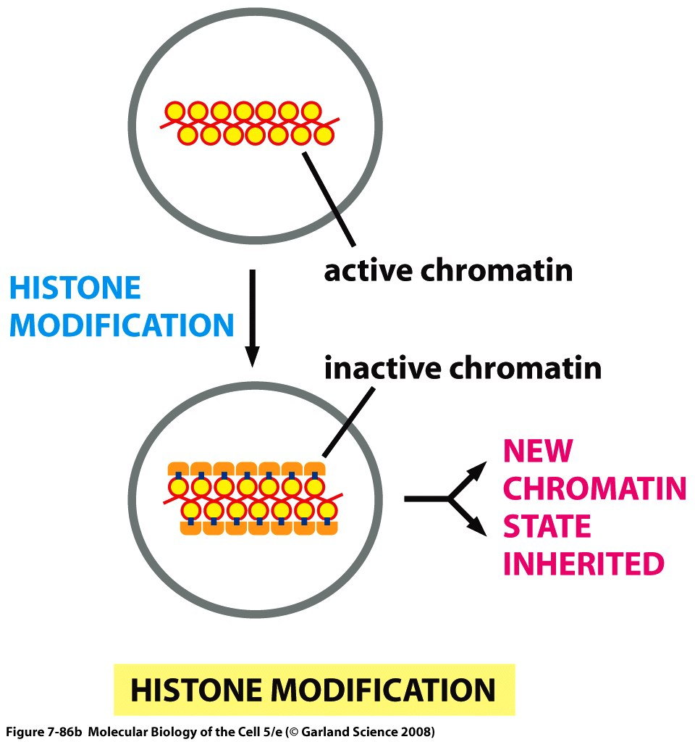
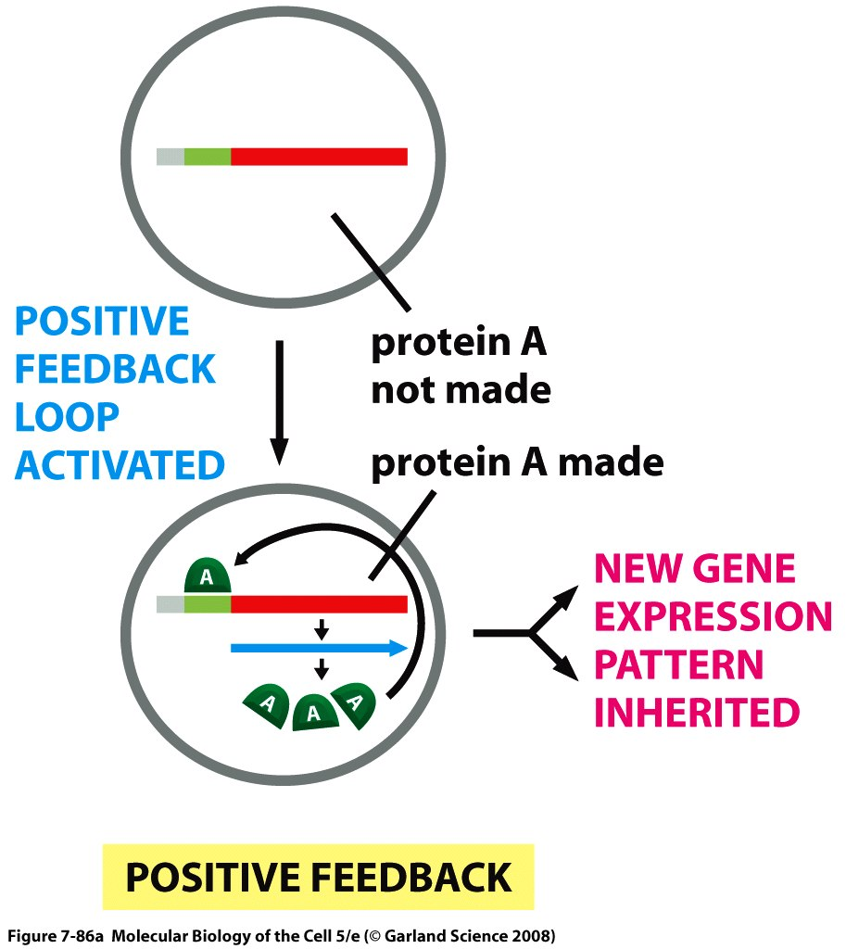
Stable patterns of gene expression can be transmitted to daughter cells

Slide 45
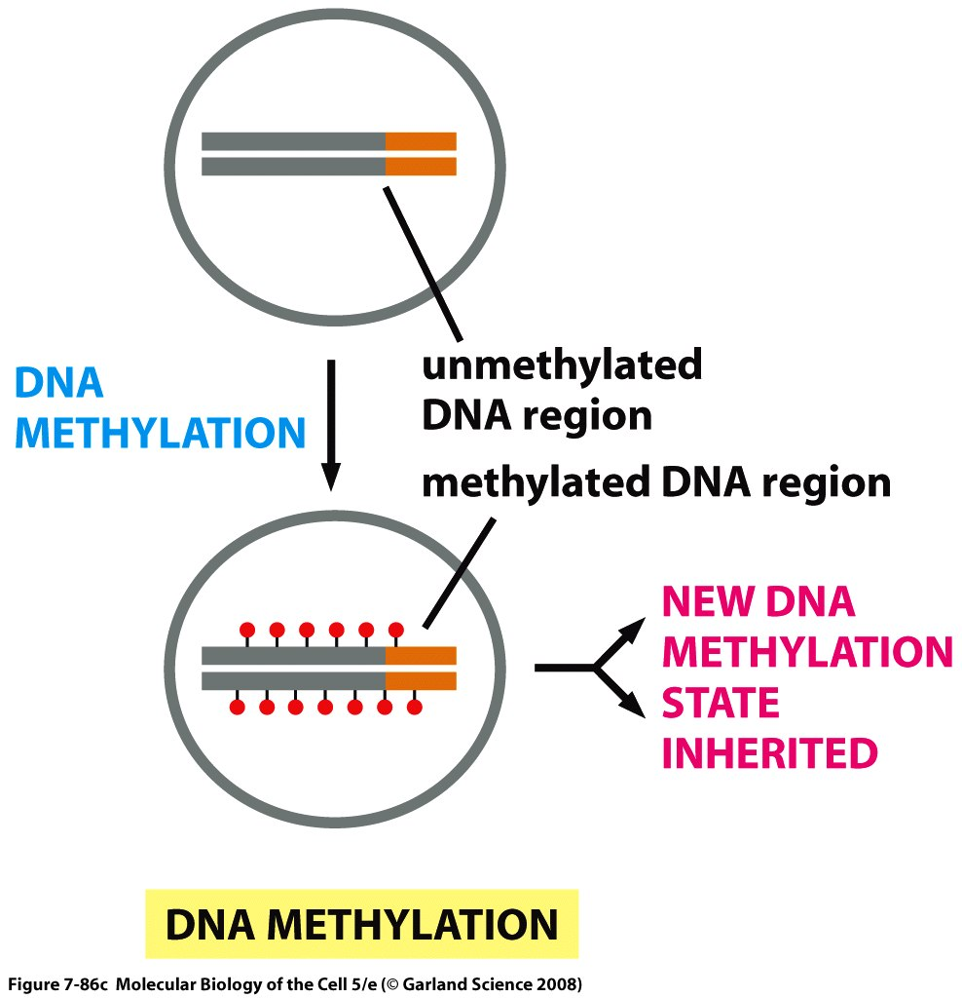
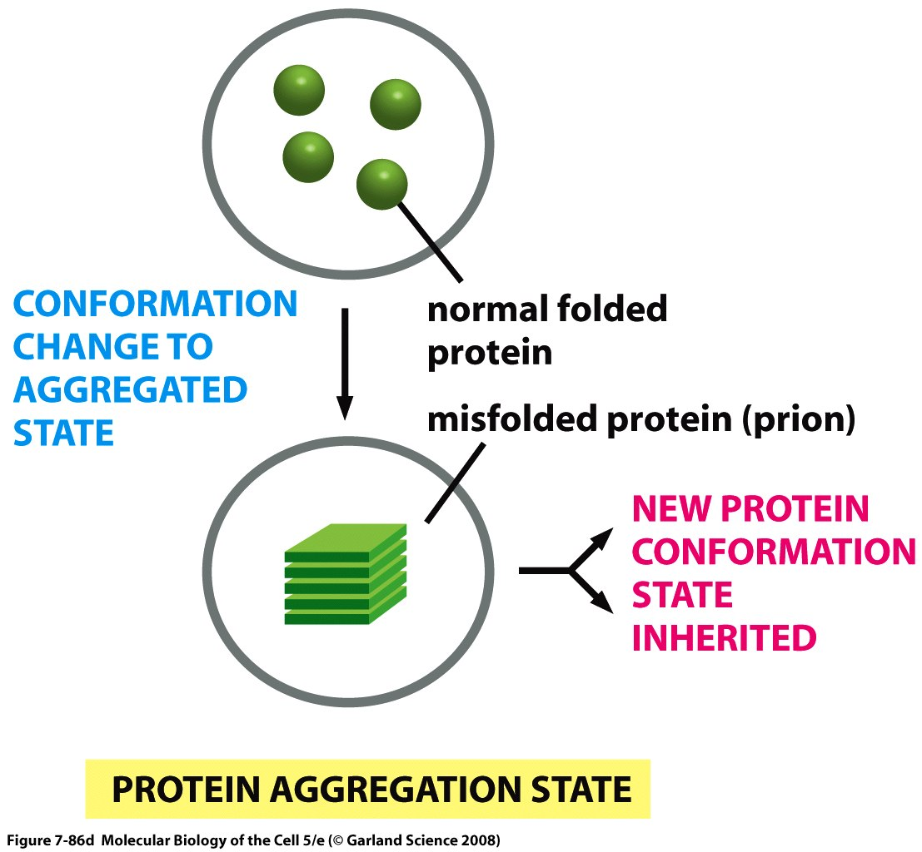

Slide 46
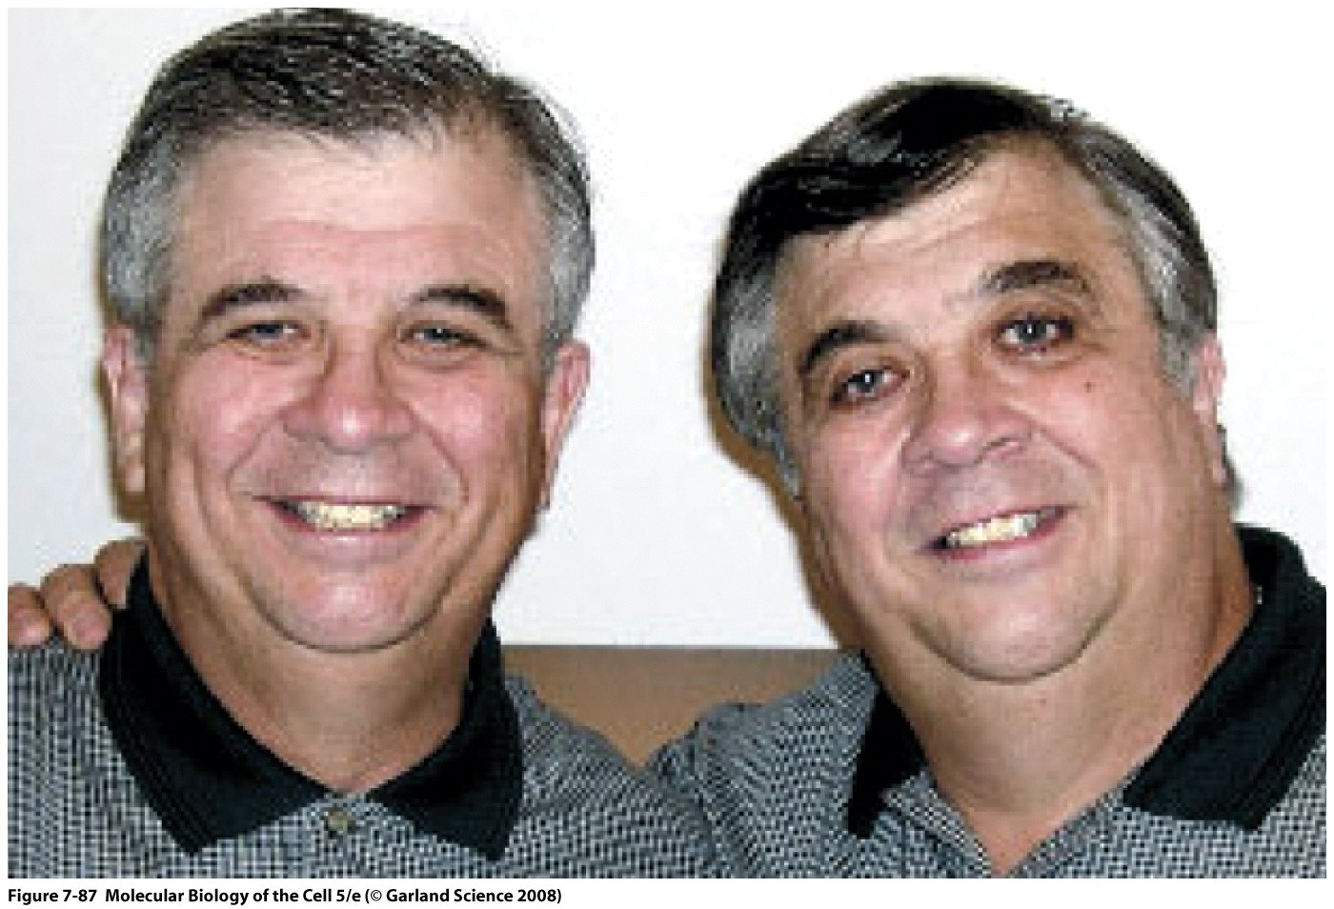
Evidence of Epigenetic Inheritance

Slide 47
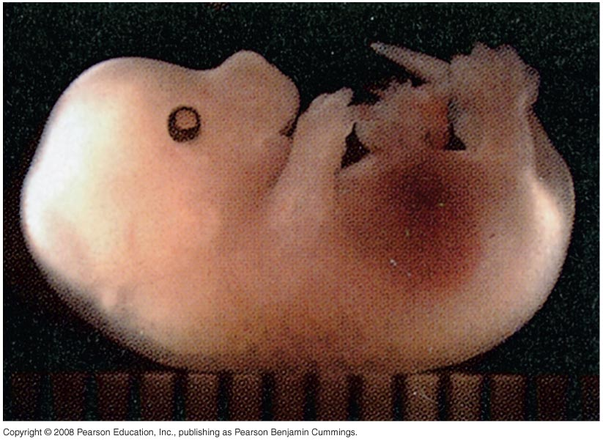
Using transcription factors to reprogram somatic cells into embryonic stem cells
Late-stage mouse embryo entirely derived from a fibroblast cells expressing the embryonic stem cell transcription factors Oct4, Sox2,
c-Myc, and Klf4.

Slide 48
